Slide 1
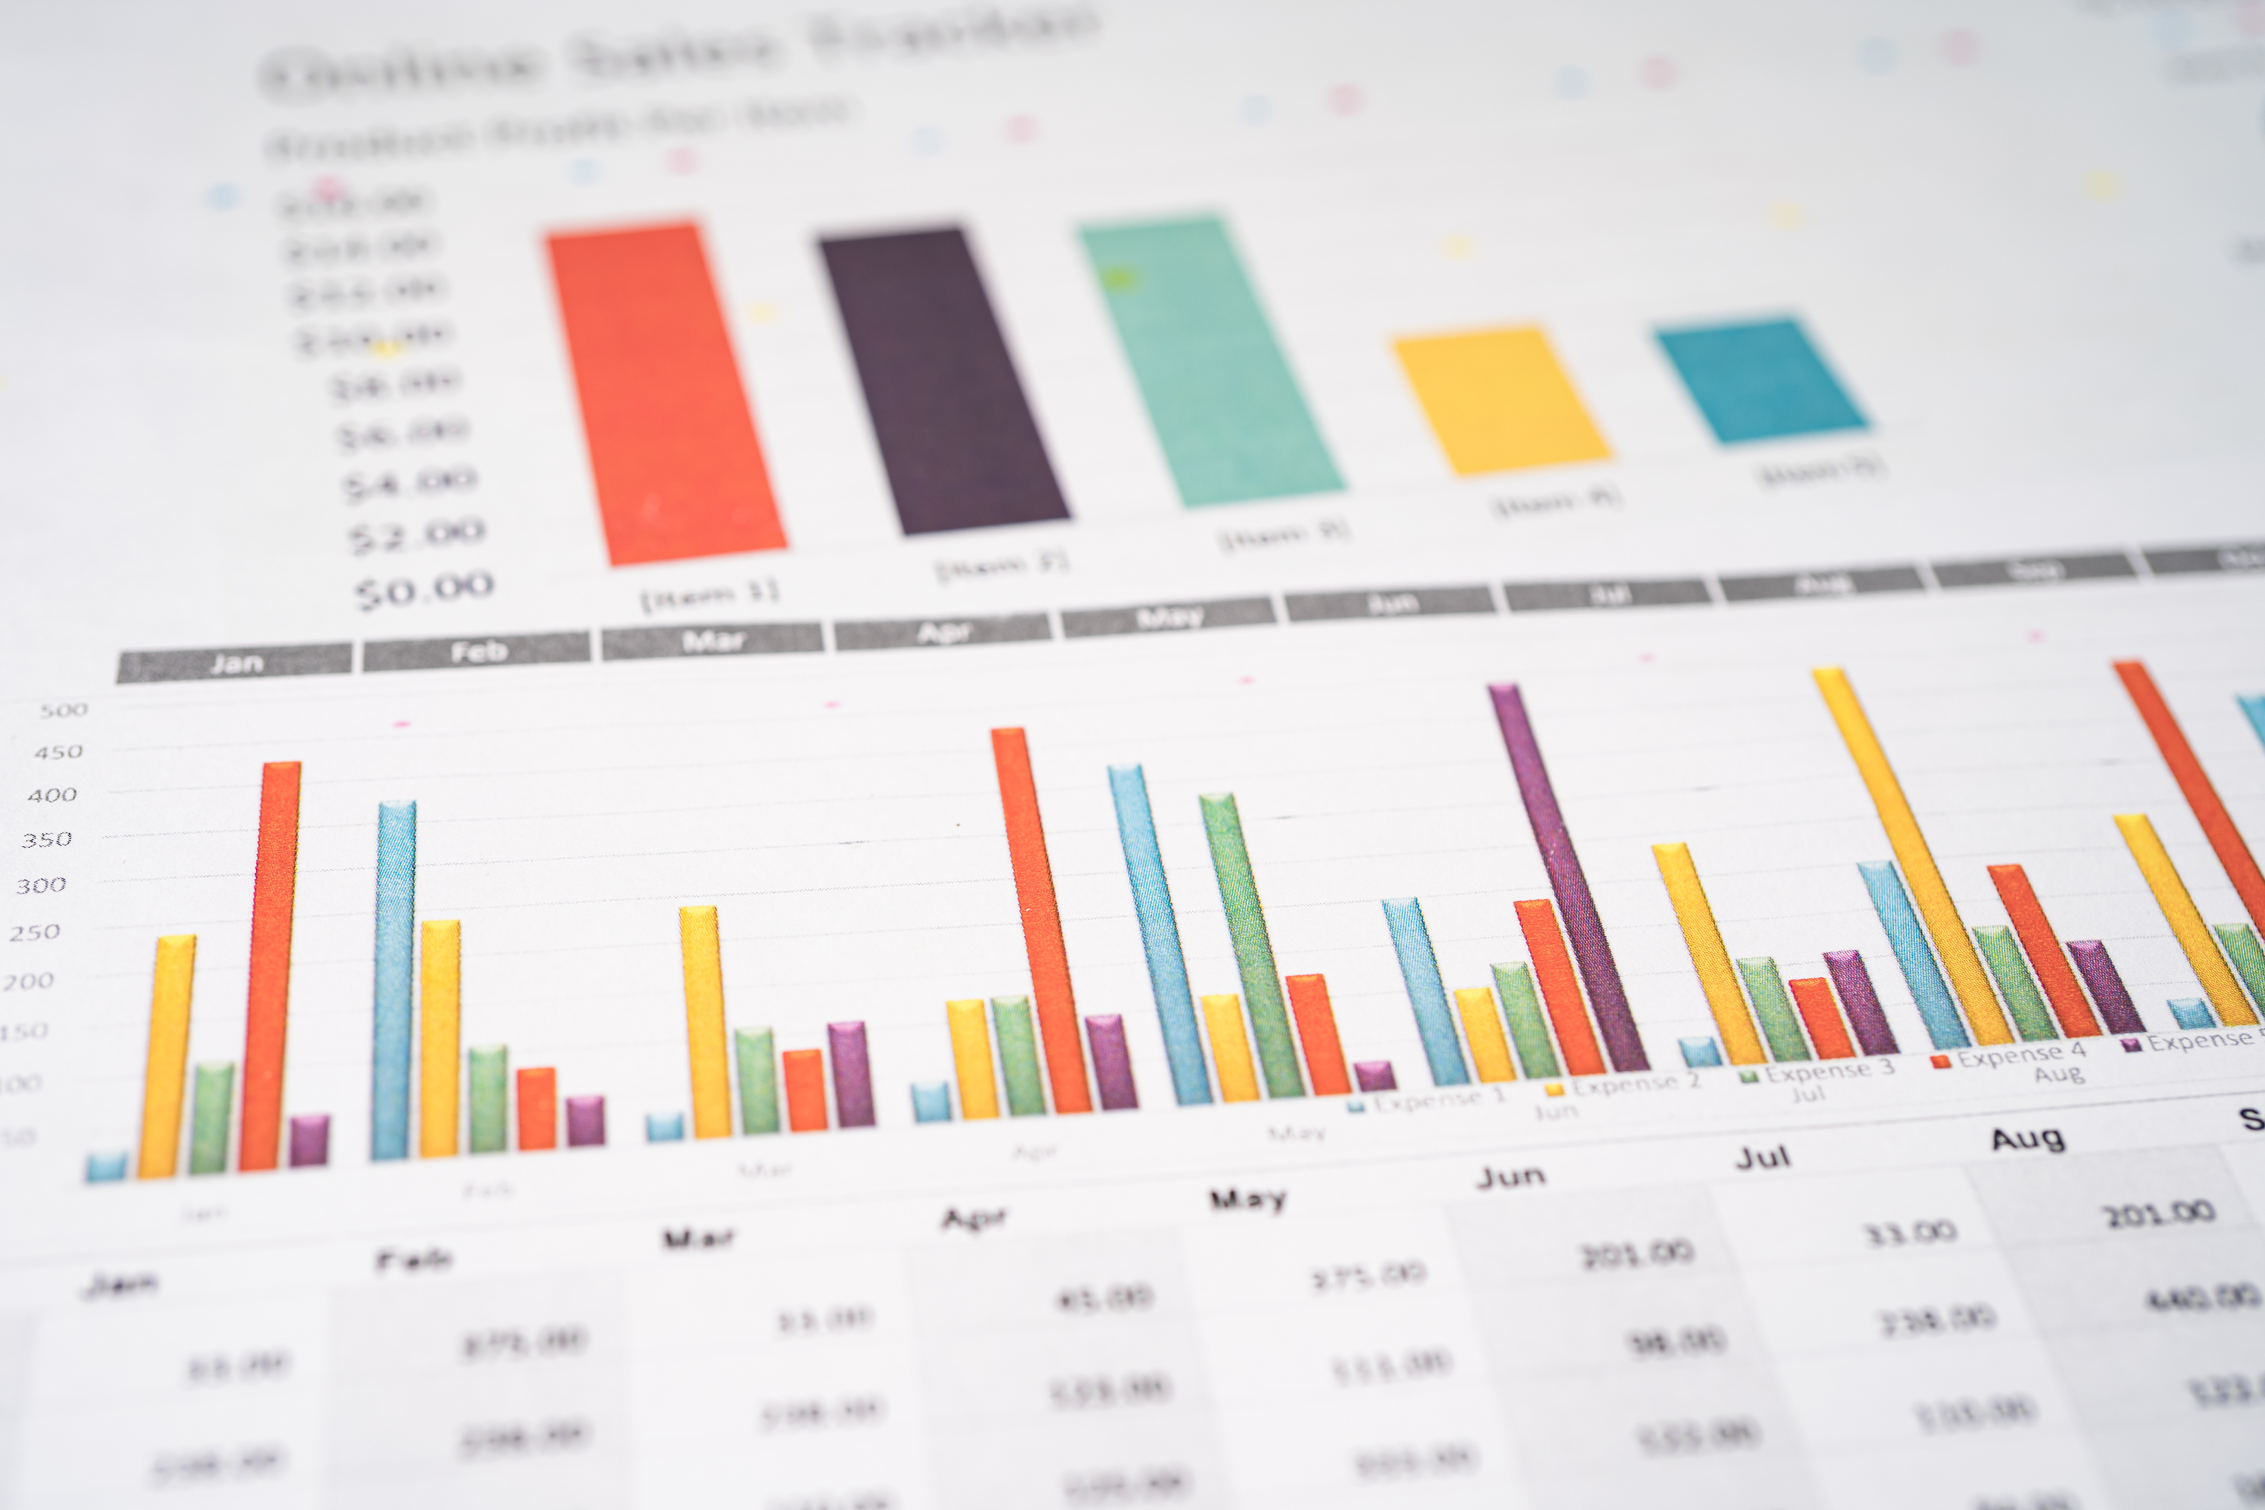

Nexthikes IT Solutions
Bike Sharing Demand Analysis Project Using Excel
PRESENTED BY VIKAS KUMAR

Slide 2
Agenda
Project Tasks :
1. Excel Foundations & Data Handling
● Navigate Excel interface, use shortcuts, and format data.
● Enter, sort, filter data accurately.
● Use basic formulas: SUM, AVERAGE, COUNT, TEXT functions (LEFT, RIGHT, LEN).
● Apply conditional formatting to highlight key data.
2. Data Loading, Merging & Cleaning
● Import datasets and merge on common keys (instant, dteday, hrs.) via Power Query or
formulas (VLOOKUP/INDEX-MATCH).
● Detect and handle missing or inconsistent data.
● Remove duplicates and correct data types.
3. Deliverables
● Excel workbook(s) demonstrating all analysis, dashboards, and automation.
● Summary document (10 pages max) describing methods, findings, and recommendations.

Slide 3
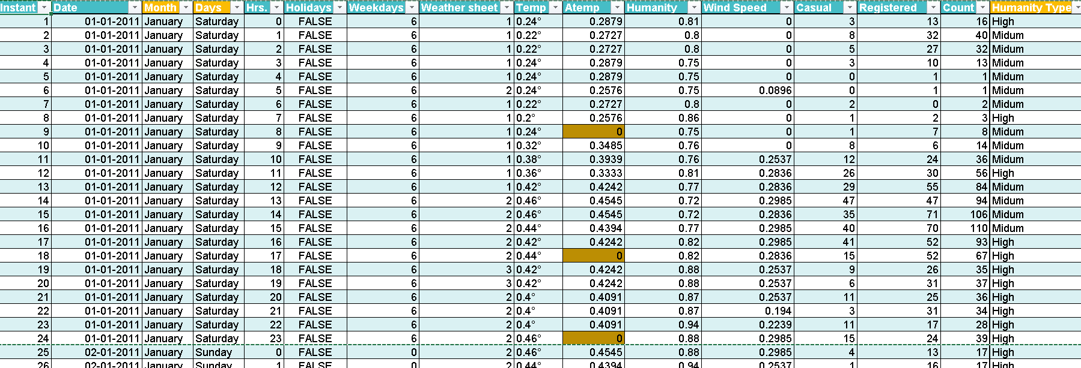
1. Excel Foundations & Data Handling
● Used basic formulas: SUM, AVERAGE, COUNT, TEXT functions (LEFT, RIGHT, LEN).
● Apply conditional formatting to highlight key data
● Remove duplicates and correct data types
● Detect and handle missing or inconsistent data
● Use IF statements for conditional classification (e.g., weekend vs weekday)

Slide 4
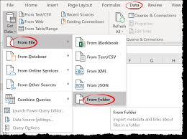
2. Data Loading, Merging & Cleaning
Merge cells by merging datasets
Using Power Query (for merging tables with a common column):
Go to the Data tab, select Get Data, then From File, and choose From Workbook or From Folder if your data is in multiple workbooks.
Select the tables you want to merge and click Transform Data to open the Power Query Editor.
In Power Query, select the primary table, go to the Home tab, and click Merge Queries.
Choose the second table and select the common column to link them. Select the join type and click OK.
Expand the new column to choose which columns to bring into your table and click Close & Load.

Slide 5
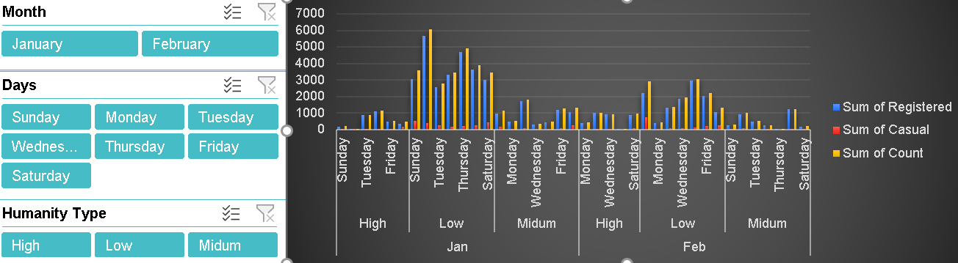
The dashboard contains three slicers/filters:
Month (January, February)
Days (Sunday–Saturday)
Humanity Type (High, Low, Medium)
The bar chart is visualizing:
Registered users (Blue)
Casual users (Red)
Total Count (Yellow)
The X-axis is grouped by
Humidity Type → Month → Day of the Week
Example:
High → Jan → Sunday, Monday, Tuesday…
The Y-axis represents the number of users/rides.
3. Hourly, Daily & Monthly Ride Analysis
CREATING EFFECTIVE CHARTS
Insight | Meaning
Higher ridership under High Humidity in January, especially on weekends | Shows seasonal/weekend behavior.
Registered users are consistently higher than casual users | Indicates strong dependence on regular commuters.
Casual users are very low across all conditions | Casual ridership is minor compared to registered.
February shows a noticeable drop in usage | Could be seasonal or weather-related.
Weekends (Friday–Sunday) show peak total rides

Slide 6
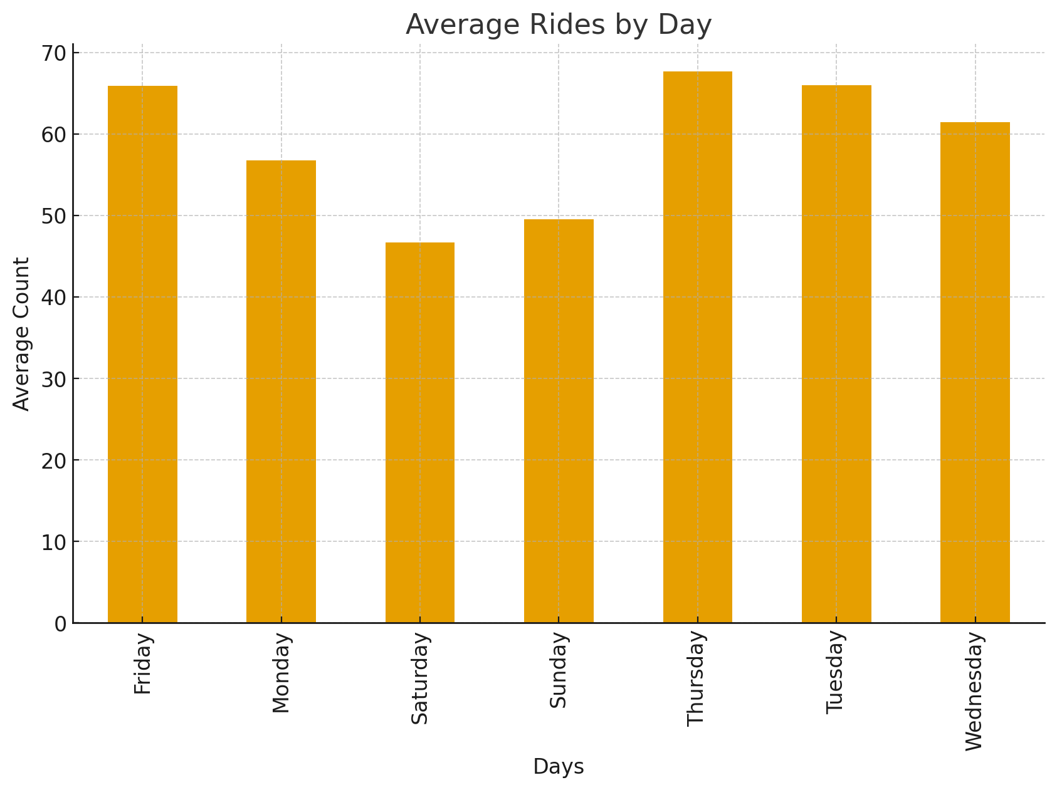
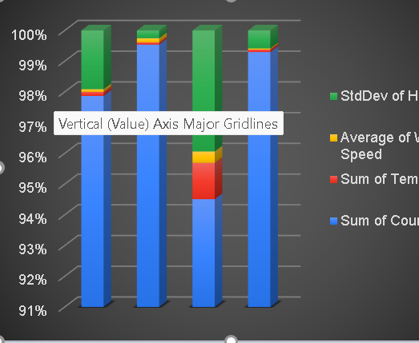
Average Rides by Day
Observations from the Chart
Thursday has the highest average ride count, making it the most active day of the week.
Saturday shows the lowest average rides, which is unusual compared to typical weekend trends.
Fridays and Tuesdays also show strong ridership, indicating peak commuter or leisure activity.
Monday shows a dip, which might suggest slower start-of-week commute behavior.
The overall distribution suggests weekday ridership is stronger than weekend ridership.
Sum of Count is the major contributing factor
Humidity variation has a moderate impact
Temperature and Wind Speed show minimal influence
Proportions are stable and consistent across all categories

Slide 7
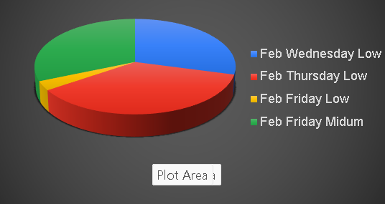
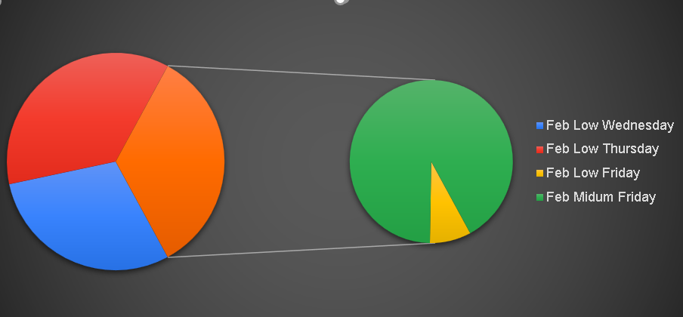
Interactive Filtering: The filter interface from the second image can be used to dynamically change the data displayed in a pie chart. Selecting options like "February," "Low" humanity, or a specific temperature range would cause the pie chart to update in real-time, showing the proportional breakdown of data that fits those criteria.
Data Representation: A pie chart could be used to visualize the data after applying the filters. For instance, after filtering for "February" and "High" "Humanity Type," a pie chart could show the distribution of wind speeds, with each slice representing a specific wind speed value from the filter list (0.2239, 0.3284, etc.).
Part-to-Whole Relationship: The pie chart would display the parts-to-whole relationship of the filtered dataset. For example, it could show what percentage of the selected data points fall into the "High" humanity category or have a temperature of "0.12.“
Simplified Visualization: Combining a filter interface with a pie chart allows for a complex dataset to be explored in a simplified, step-by-step manner. The filters narrow down the focus, and the pie chart provides a clear, at-a-glance visualization of the resulting subset.
Misspelling in Data: As noted in the second image, the label "Midum" for "Humanity Type" would need to be addressed for accurate data categorization and filtering.

Slide 8
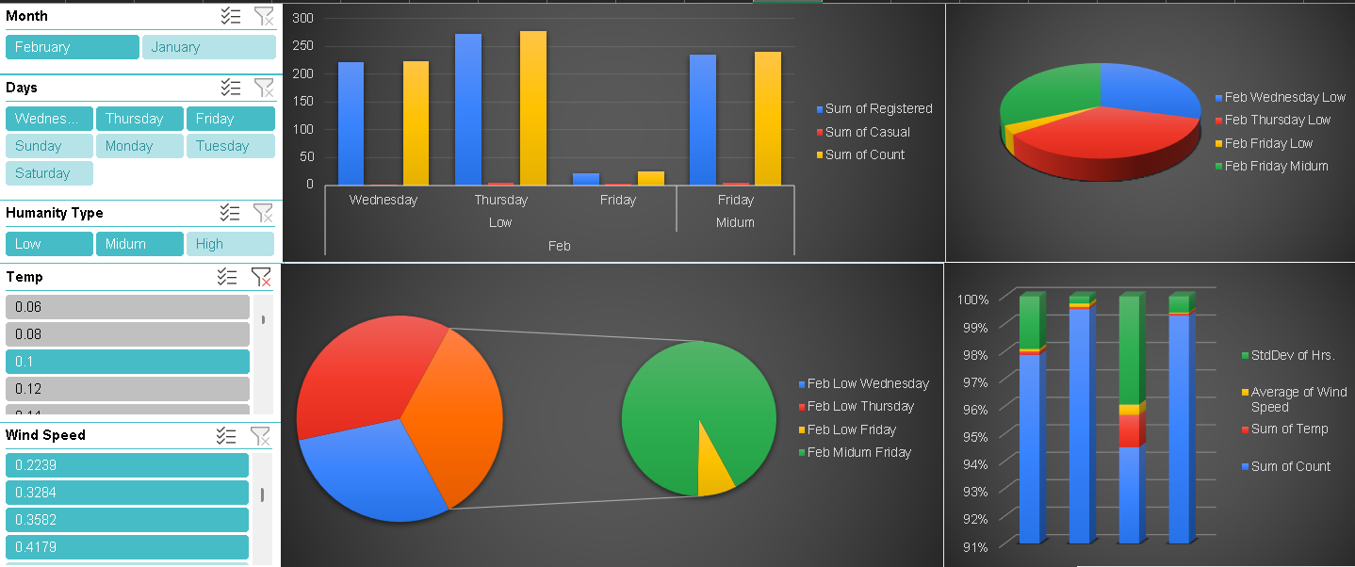

Slide 9
Conclusion & Insights
• Ride demand peaks during working hours and weekdays.
• Weather conditions influence ride counts.
• Rain and cold weather reduce demand.
• Trends can guide scheduling and resource optimization.

Slide 10
Thank You

